Slide 1

PROJECT UPDATE
Team Members:
(Quino) Joaquin Carretero Martinez
Himanish Prakash
(Doris) Mengyu Pu
(Sreeja) Sai Sreeja Macha

Slide 2





EXECUTIVE SUMMARY– SENTIMENT ANALYSIS
Q: How can a new call-to-action plan with Twitter posts enhance attendee retention and engagement rates at conferences?
A: Boosts attendee retention by 10% and increases attendee engagement rate by 25%, potentially adding an extra $50K in revenue
from repeat and engaged participants.
VALIDATION: OOS 5-fold cross-validation shows that the estimate is 85% accurate.
We're 95% confident that the actual increase in the attendee rate falls within a range of ±2%, and the improvement in engagement level falls within a range of ±5%.
KPIs:
Attendee Retention Rate
Attendee Engagement Level
Observations: 2,000 tweets analyzed to date.
Business Outcome: Revenue Impact
DATA:
Source: Twitter, LinkedIn
Targeted Tweets: Tweets using targeted hashtags like #INFORMS, #INFORMS2023, etc.
Variables: 10 (incl. Sentiment Score, Hashtag, Engagement Rate, Tweet Volume).
Timeframe: Nov 2023 – Mar 2024.
METHODOLOGY: Lasso Logistic Regression model for classifying tweets and performing sentiment analysis, followed by regression analysis to determine the impact on attendee retention and engagement rates.
ROADMAP:
Tweets Collection
Data Analysis
Feb 01, '24
Modeling
Advanced Analysis
Feb 12, '24
April 02, '24
Jan 15, '24
May 28, '24
Reporting
June 15, '24
Project Closure
Notes:
What value do we get from having real time attendee feedback?
By getting to the root of the issue within 3h, we can get better attendee retention and engagement rates for other conferences.
What does it look like? Increase in 20% of attendees year to year due to better reviews
Does adding particular hashtag linked to conferences help in better conversion of participants?
How can these insights guide strategic improvements in conference planning and execution?
DATA:
Source: Twitter
Element: posts with "@INFORMS", "#INFORMS"
Period: from date to date
METHOD:
Used sentiment analysis to analyze existing twitter posts to get positive and negative comments.
Completed a business proposal on how to use #INFORMS more effectively to increase #INFORMS utilization
ROADMAP:

Slide 3
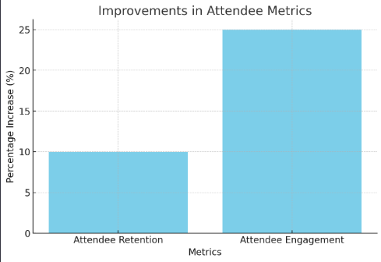
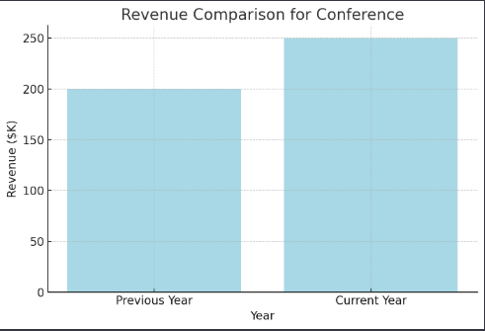
Mock-Up Results– SENTIMENT ANALYSIS
Increase in Attendee Retention by 10% and Attendee Engagement by 25%
Increase in revenue by $50k

Slide 4
METHODOLOGY – PATH TO SUCCESS
1. Define Objectives:
Goal: Instantly track and act on feedback from social media for INFORMS conferences.
2. Set Up Monitoring:
Monitor social media for mentions using keywords like "#informs", "INFORMS", and other relevant terms.
3. Data Collection:
Automatically collect posts and comments mentioning these keywords in real time.
4. Quick Analysis:
Filter and categorize feedback (logistics, content, etc.).
Assess sentiment (positive, negative, neutral).
5. Immediate Action:
Identify and implement quick fixes during the conference based on feedback.
6. Performance Assessment:
Compare feedback volume and sentiment against previous events to gauge impact.
7. Reporting:
Summarize key feedback and actions taken for executive review.
Use insights for future event planning improvement.
8. Adjust and Refine:
Post-event, refine strategy for better feedback capture and action in future conferences

Slide 5
EXPLORATORY DATA ANALYSIS: KEY VAIRABLES
Continuous Variables Summary:
Variable | Definition | Number(Actively adding) | Calculation | Missing
replies | Reply number for each posts | 2000+ | NA | 0
retweets | Retweets number for each posts | 2000+ | NA | 0
likes | Likes number for each posts | 2000+ | NA | 0
Sentiment Score | Assess sentiment (positive, negative, neutral) | 2000+ | Based on Sentiment analysis | 0
Engagement Rate | Number of people actively engaging with social media content | 2000+ | SUM(like, retweet) | 0
Tweet Volume | Sum of posts and comments for a period | 2000+ | COUNT(tweet_id) GROUP BY(DAY) | 0
Categorical Variables Summary
Variable | Definition | Number | Missing
tweet_id | Unique ID for every post | 2000+ | 0
text | The content of each post | 2000+ | 0
username | Distinct username | 2000+ | 0
timestamp | Post Release Time | 2000+ | 0
Hashtag | Hashtag used in the post | 2000+ | 0

Slide 6
Method: Social Media Engagement Analysis
Model:
SocialM ediaM etric = f(Conference_Activities, #Hashtag_Usage, Related_Keywords, Time, Other_Controls, Historical_Attendance_Data)
Objective:
Quantify the impact of the new Twitter call-to-action plan on real-time attendee engagement and retention, leveraging INFORMS conference data.
Approach:
Data Aggregation: Collect and integrate social media mentions with historical attendance records during the conference timeframe.
Metric Analysis: Track volume, sentiment, and engagement of INFORMS-related posts.
Comparative Metrics: Contrast social media activity before, during, and after the conference to assess impact.
Challenges:
Filtering out noise and irrelevant mentions.
Accurately interpreting sentiment of feedback.
Tools & Software: Apify LinkedIn, Twitter, Instagram APIs, Python, R, ChatGPT
Success Evaluation:
An increase in attendee retention rate.
Enhanced engagement metrics (likes, shares, comments).
Increase in overall revenue.

Slide 7

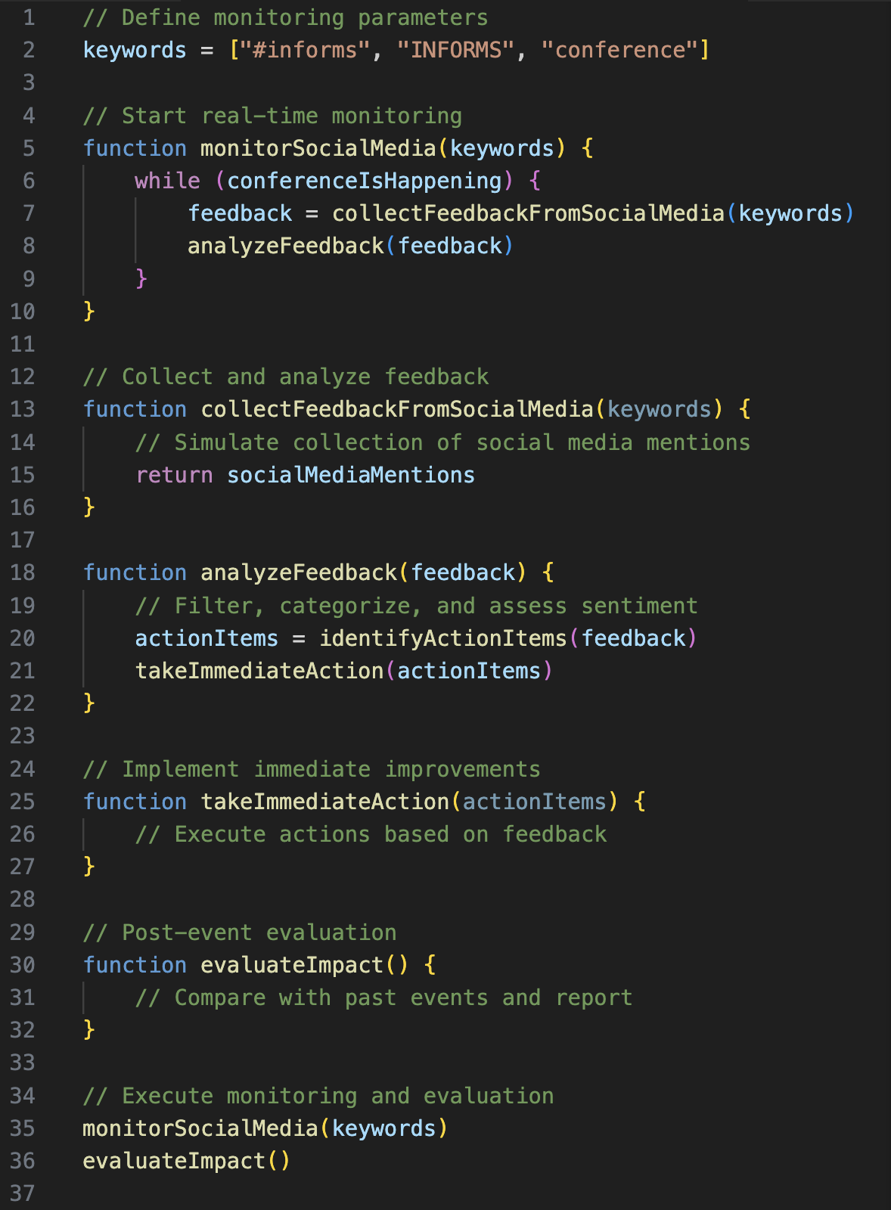




Pseudo-Code

Slide 8
Audience Analysis
Key goals and priorities
Beliefs and preferences
Expectations
Opportune timing
Increase number of participant in the INFORMS conferences
Better and instant support makes customers happier. This is Business 101
Increase in retention rate of new members → High Business Impact
Upcoming conference which is going to be held in April

Slide 9
Audience Analysis
5) Topic Familiarity
6) Data Literacy
7) Seniority
8) Audience mix
Not much Familiar with data and coding, so requires a more business focused explanation
Audience is estimated to be well educated with background in business, who understands graphs and math
Audience must be aware of our project and the problem to be solved
Mix of end user, senior executives and marketing team

Slide 10

Have an Insight?
Will it be new-news to the audience?
Yes, Now INFORMS uses a specialized hashtag for conference every year but does not have a systematic analysis of this X (Twitter) post, nor does it implement a call-to-action plan.
If acted on, will it have a sizable business result?
Addressing attendees' issues in real-time during the conference can enhance attendee satisfaction, increase user retention, and boost the likelihood of their participation in future events. Additionally, increasing activity on social media platforms can raise INFORMS's public exposure, attracting potential users.
Is it something the audience has the power to act on?
We expect INFORMS to encourage attendees to share their real-time thoughts, suggestions, or opinions on X platform with a certain hashtag during the conference, which will be analyzed by our model next. In the end, INFORMS can make feasible adjustments to the conference based on the results.
Is it something that can be acted on now?
Action can be implemented in the first conference after we've finished modeling.
Is the risk and/or cost of acting on it small?
The risk is in the willingness of the attendees to increase their posting, which can be address with some incentives to increase hashtag usage. Another risk would be the accuracy of the sentiment analysis model, which could be improved by model training.

Slide 11
Drama Questions
What do we need to get started?
Solving this problem requires a particular team of Software Engineers, Business Analysts, and Data Scientists as well as deep knowledge of Machine Learning, Web Scraping, Social Media and Cloud Services. We spent months producing this plan and creating a minimum viable product, which so far resulted in success. Our Practicum Team is ready to take the challenge!
Can we live without this new platform?
Totally! Feel free to spend countless months pushing through surveys and team of analysts and data scientists to gather all social media data manually
– A waste of time and money if you ask us
Can a computer actually understand comments better and act upon them?
Our State-of-the-art Sentiment analysis algorithm successfully load thousands of requests from different social media tools within seconds to provide you with accurate understanding of customer feedback.
What hurdles would we go through?
Informs doesn’t have a large social media reach. We must encourage customers to engage with us to make this work.
The Algorithm must be precise and output easy to understand solutions that don’t require engineering background.
We will be making a hands-free automation platform from scratch, which requires lots of software planning and looking at problems that might arise years down the line.

Slide 12





Data Storytelling Arc Narrative
3
Aha moment
The insight gained from immediate feedback allows for on-the-spot resolution of issues, significantly improving attendee satisfaction.
2
4
Rising Insights
Real Time social media sentiment analysis becomes the perfect tool for automated feedback. It also boosts social media reach, therefore, more potential customer reach.
Solution
We will implement the Social Media Automated system to tract sentiment analysis and create a business plan to deploy at conferences by end of May.
Next Steps
Create plan to gather data – Automation solution.
Testing phase in collaboration with Marketing team.
Business plan – Decide hashtag that will be shared.
Deployment – Craft public statement that will be shared.
Gather data in during first year.
Analyze results based on customer feedback.
1
Setting
Improve action on customer feedback in real time is required for better churning

